Slide 1
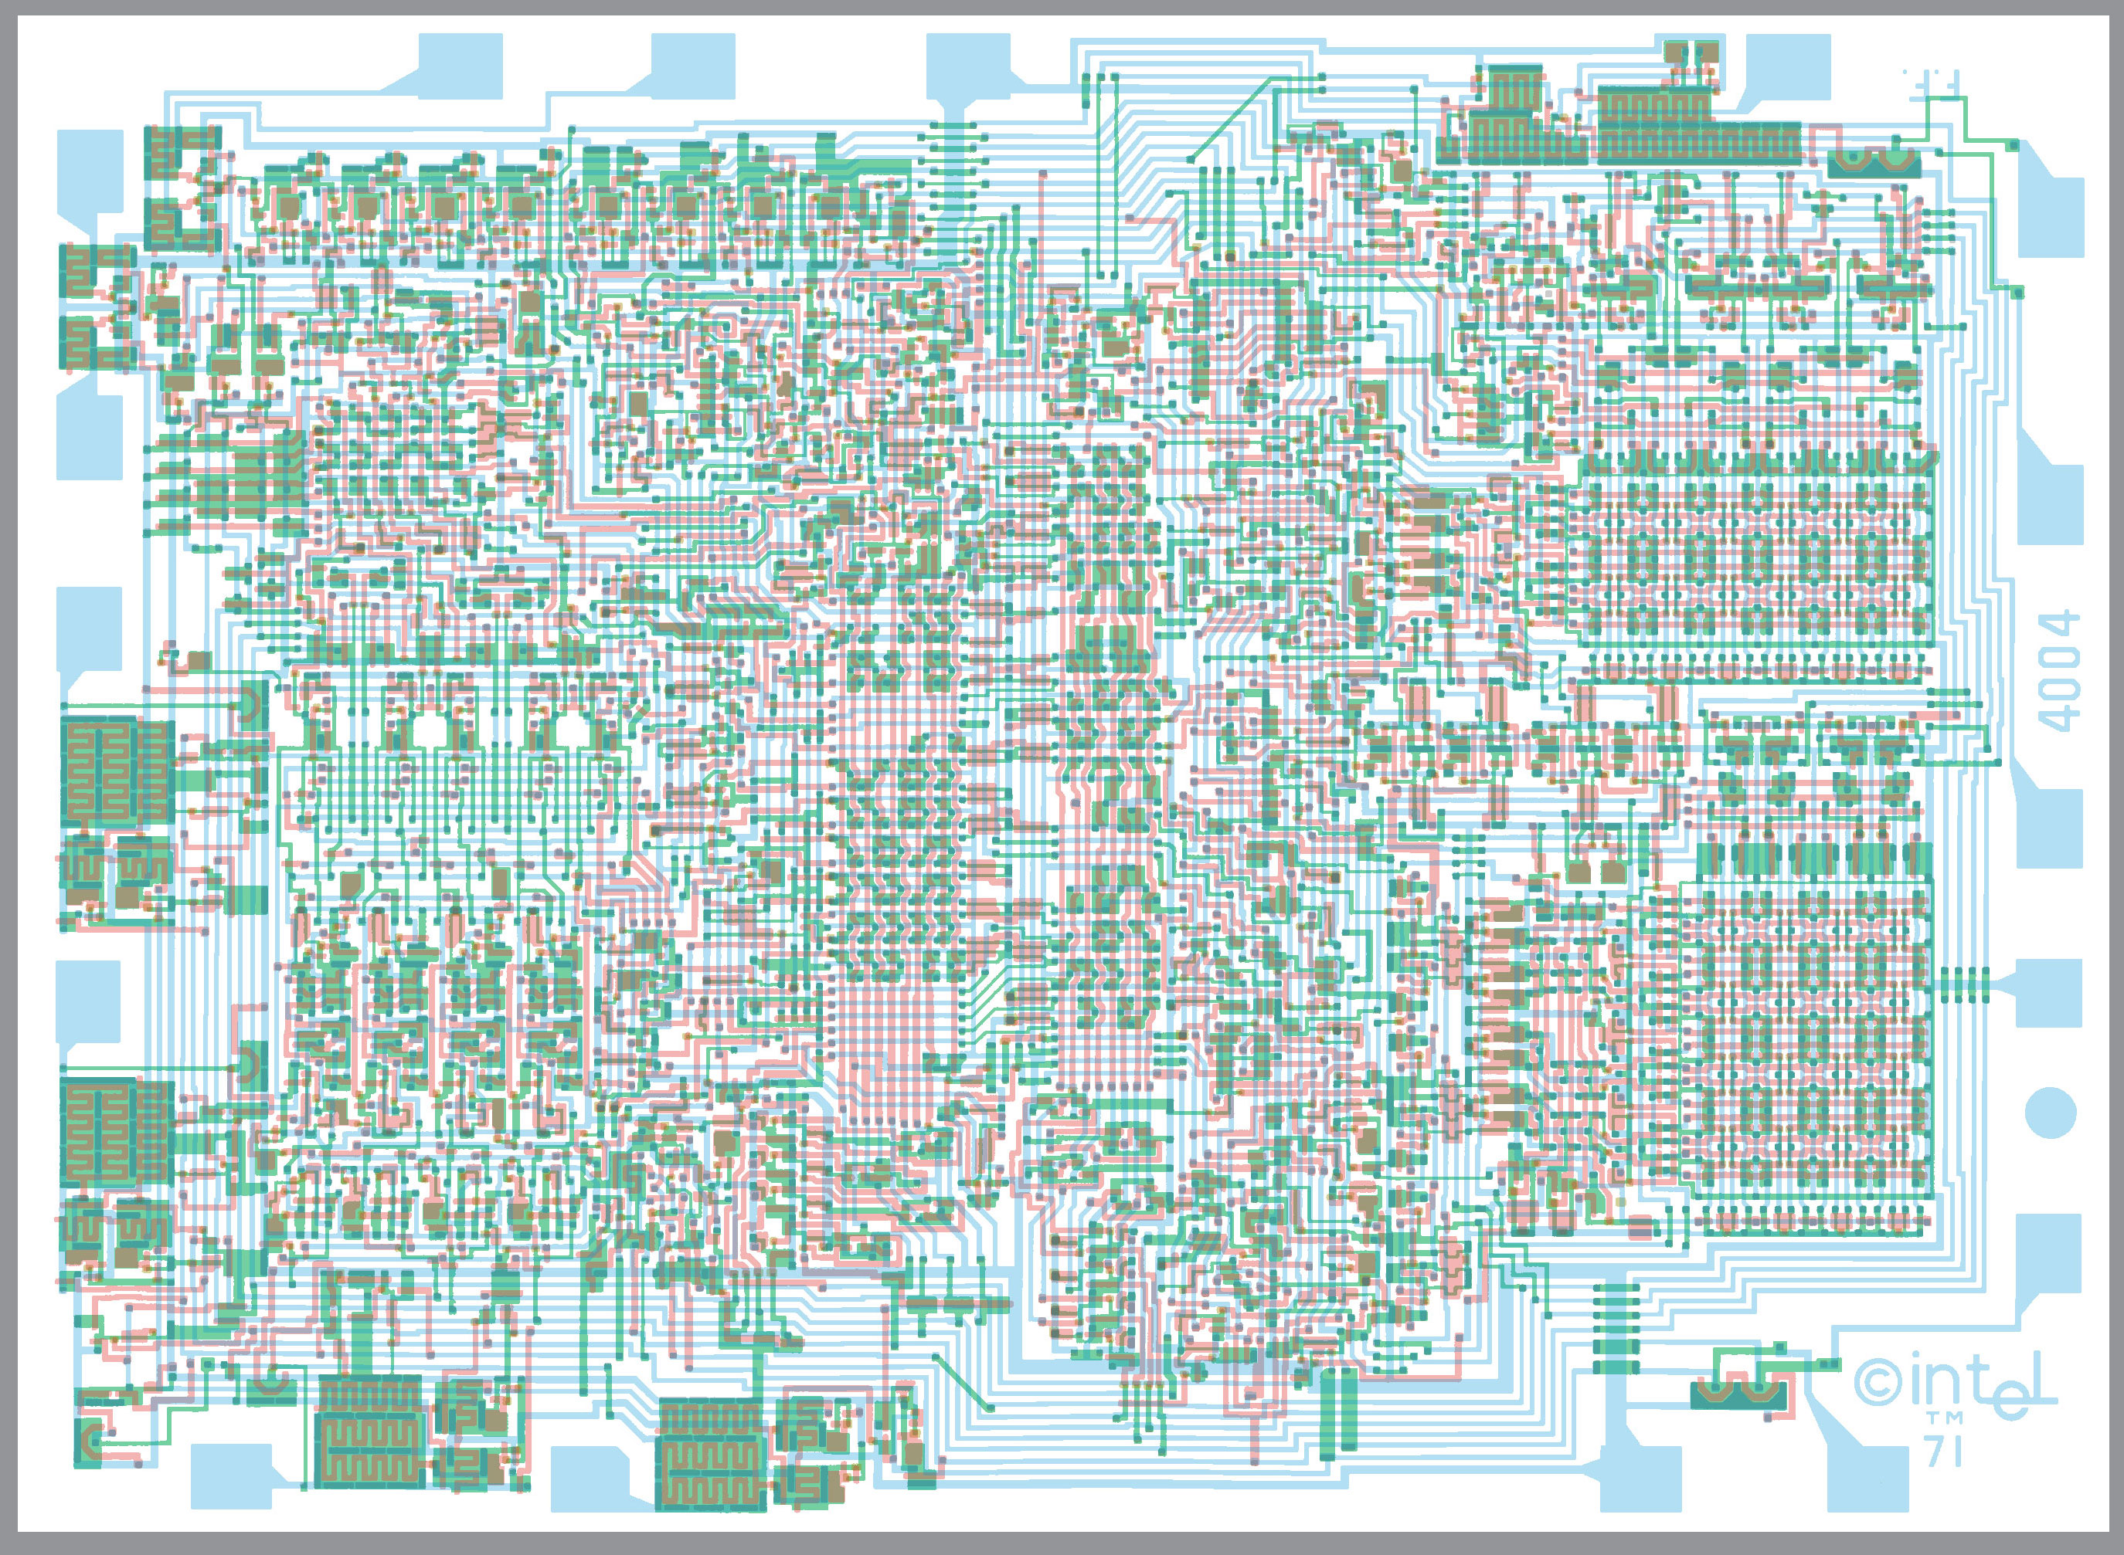
CPU Micro Architecture

Slide 2
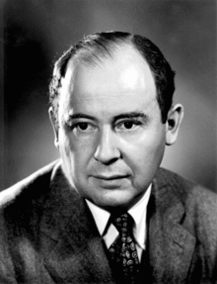

Architecture: Von Neumann Vs Harvard
Von Neumann
All memory together
Everything is in one address space
Program, Data, who cares?
No partitioning problem
Harvard (Howard Aiken)
Program memory & data memory
2 different address spaces
Programs in different memory
Hard to debug
Can’t JIT or self-modify code

Slide 3
What Does a CPU Do?
Integer Math (add, subtract, multiply, divide)/Logic (and, or not, xor)
Data Transfer : Loads and Stores ←→ Memory
Generate and handle interruptions
Control: Branch, Jump, Call/Return
System: Ring Changes, Virtual Memory Control
Floating Point/Decimal: add, subtract, multiply, divide
Special: String, Graphics, Other

Slide 4
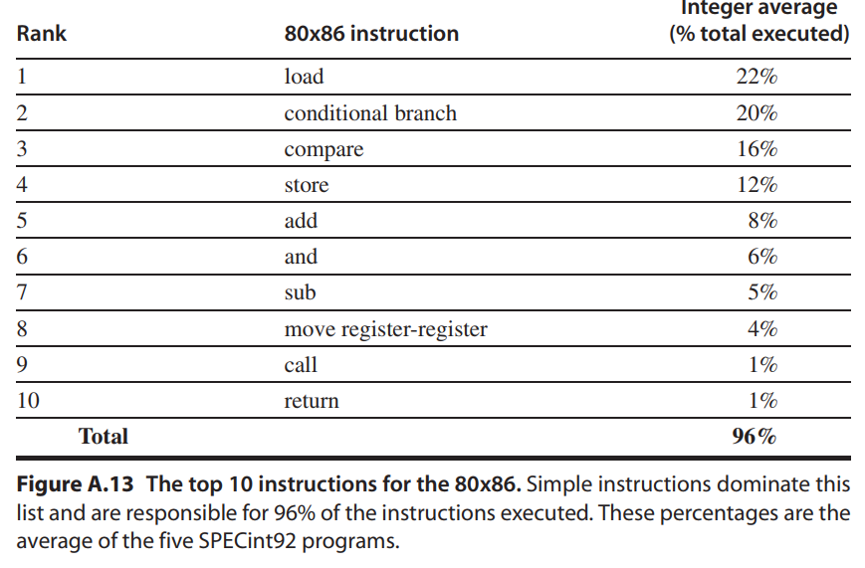
Instruction Use Frequency

Slide 5
What does a CPU do (alternate view)
Store Results
Fetch
Instruction
Execute
Instruction
Decode
Instruction

Slide 6
Fetch Instruction
Every CPU has a register called the PC or program counter.
This CPU points to the address to fetch NEXT.
In the fetch “phase”, the contents of PC is sent to the memory controller in a read request.
The memory contents come in on the data bus and are stored in a register used only as a source/destination for memory access.

Slide 7
Decode Instruction
Decode steps depends on the instruction. Possibilities include:
Fetch memory
Break instruction into micro-operations
Schedule instructions (more on this later)
Setup data flow from memory/registers for execution
Increment PC – execution might overwrite

Slide 8
Execute Instruction
Execution, of course, depends on the particular instruction
Over the next few slides, we will look at some examples.

Slide 9
Store Results
Update the state of the system with our results.
Registers or memory – if either is updated, this is the stage where that work is completed.

Slide 10
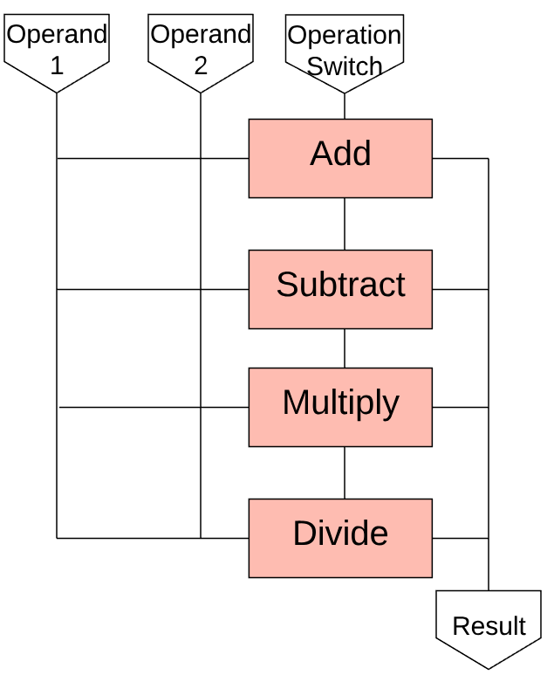
ADD
You already know ADD! The data (from the decode) is placed on the “bus” for a series of adders.

Slide 11
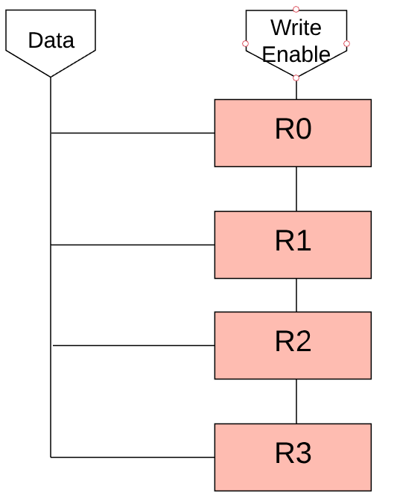
Load
In the decode stage, the CPU requested the memory location that we are loading from.
Here, we need to copy the data from the memory transfer register to a register:

Slide 12
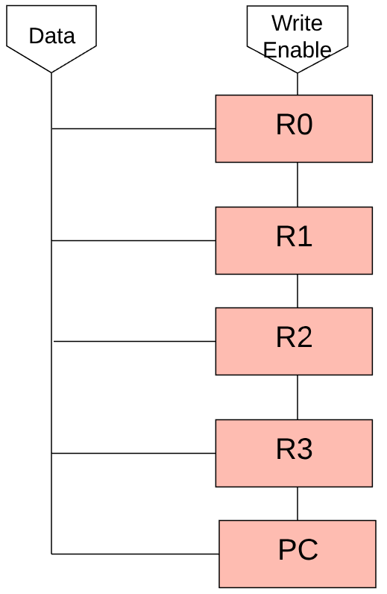
JUMP
In the decode stage, the CPU determined the memory location that we are jumping to.
If we think of PC as just another register…

Slide 13
Branch
There are 6 branch types – this must be complex, right?
BEQ, BNE, BGT, BLT, BGE, BLE
How can the CPU tell if R1 > R2?
The CPU subtracts R2 from R1. If the sign is positive, R1 > R2.
If they are equal, the result will be 0.
If R2 is greater, the sign will be negative.
How can we test for positive, negative and 0?

Slide 14
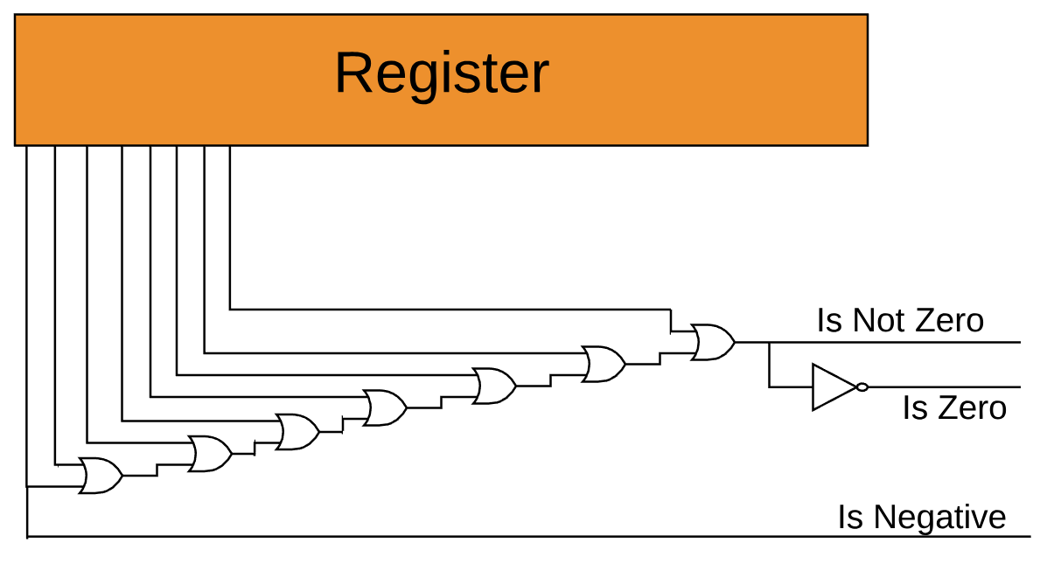
Testing

Slide 15
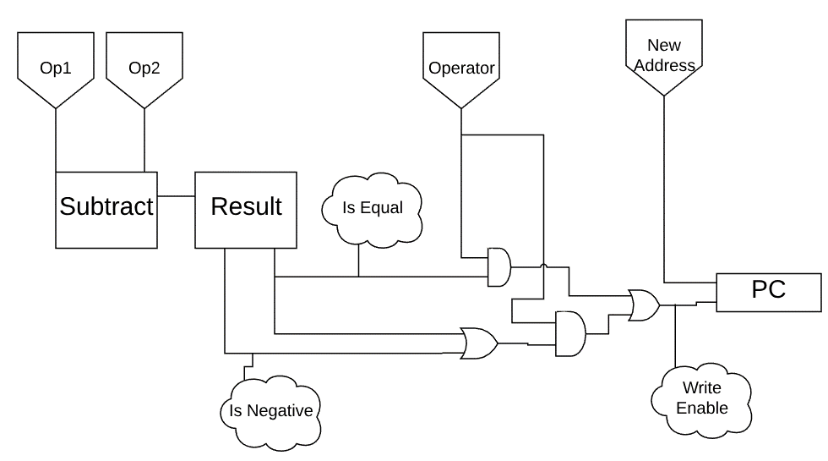
Branch Block Diagram

Slide 16
A more compact way to express operations
The pretty pictures take up a lot of space and take time to draw. CPU architects use a different, almost pseudo-code approach.
load looks like this:
Regs[rt] ← Mem[rs]
jump looks like this:
PC ← Imm
We will use this notation from now on…

Slide 17
What determines the clock speed?
The time of the longest instruction in a single cycle machine.
Otherwise, there is a tradeoff – a 5ghz computer where every operation takes > 10 cycles is not useful…

Slide 18
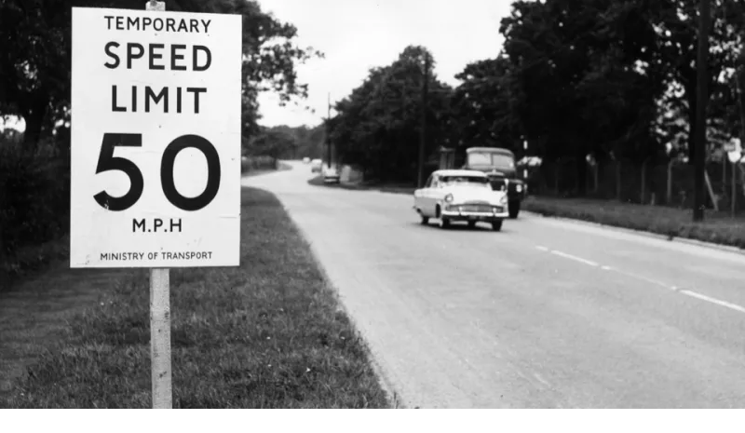
Performance Problem
Fetch takes a memory access
Decode and Execution take some time
The signal has to travel some distance within the CPU
If we want a 10mhz computer, this is not a problem
What if we want to increase our speed?

Slide 19




How do they design all of this?

Slide 20
Layers of Abstraction
Much like a software project
Different people work on different parts
They build modules and reuse them (like an adder)
They iterate on previous versions of the chip

Slide 21
Verilog
module toplevel(clock,reset);
input clock;
input reset;
reg flop1;
reg flop2;
always @ (posedge reset or posedge clock)
if (reset)
begin
flop1 <= 0;
flop2 <= 1;
end
else
begin
flop1 <= flop2;
flop2 <= flop1;
end
endmodule
Verilog is a hardware description language – a DSL.
Circuit designers can write Verilog, simulate and test it, then use synthesis software which will convert (compile?) it into a description using only AND, OR, NOT, etc.
That description, called a netlist, can then be processed and laid out on a mask which can be used to etch silicon.

Slide 22
VHDL
-- import std_logic from the IEEE library
library IEEE;
use IEEE.std_logic_1164.all;
-- this is the entity
entity ANDGATE is
port (
I1 : in std_logic;
I2 : in std_logic;
O : out std_logic);
end entity ANDGATE;
-- this is the architecture
architecture RTL of ANDGATE is
begin
O <= I1 and I2;
end architecture RTL;
Started with the US DOD in 1983. Now an
IEEE standard. Unlike Verilog, VHDL is strongly
typed.

Slide 23
What’s next in chip design?
We are coming to the end of smaller gates
We are coming to the edge of how much heat we can remove
We have removed all of the unnecessary distances
We have gone to multicore
We are close to the end of clock speed improvements
We shut down cores not in use to save power/heat and overclock those in use
We are putting a LOT more die space into caching then instruction improvements.

Slide 24
A few ideas…
Specialized cores – we already do this with GPUs (and more)
Instruction set improvements – no one really has a better ISA
Quantum – weird, commercialization is questionable, solves different problems
Near-Memory Processing – merge CPU and RAM to reduce access time

